Slide 1
6. Ensemble Learning (I)
IT 348/448

Slide 2
Topics
Ensemble Learning
Bagging
Boosting
Random Forest

Slide 3
The Increased Expressive Power by Ensemble Learning

Slide 4
General Approach of Ensemble Learning
Using majority vote or weighted majority vote
(weighted according to their accuracy or relevance)

Slide 5
Ensemble Learning: Increasing the Accuracy
Ensemble methods
Use a combination of models to increase accuracy
Combine a series of k learned models, M₁, M₂, …, M_{k}, with the aim of creating an improved model M*
Popular ensemble methods
By manipulating the training set
Bagging: averaging the prediction over a collection of classifiers
Boosting: weighted vote with a collection of classifiers
By manipulating the input features
Random forest: a subset of features is chosen to form each training set

Slide 6
Combining classifiers
Examples: several neural networks, several classification trees, etc.
Majority votes or average results from different models
Why?
Better classification performance than individual classifiers
More resilience to noise
Why not?
Time consuming

Slide 7
Ensemble Methods
Construct a set of base classifiers learned from the training data
Predict class label of test records by combining the predictions made by multiple classifiers (e.g., by taking majority vote)

Slide 8
Bagging

Slide 9
Bagging (Bootstrap AGGregatING)
Analogy:
Diagnosis based on multiple doctors’ majority vote
Bootstrap sampling:
A technique that repeatedly samples with replacement
Each bootstrap sample has the same size as the original data
Build classifier on each sample

Slide 10
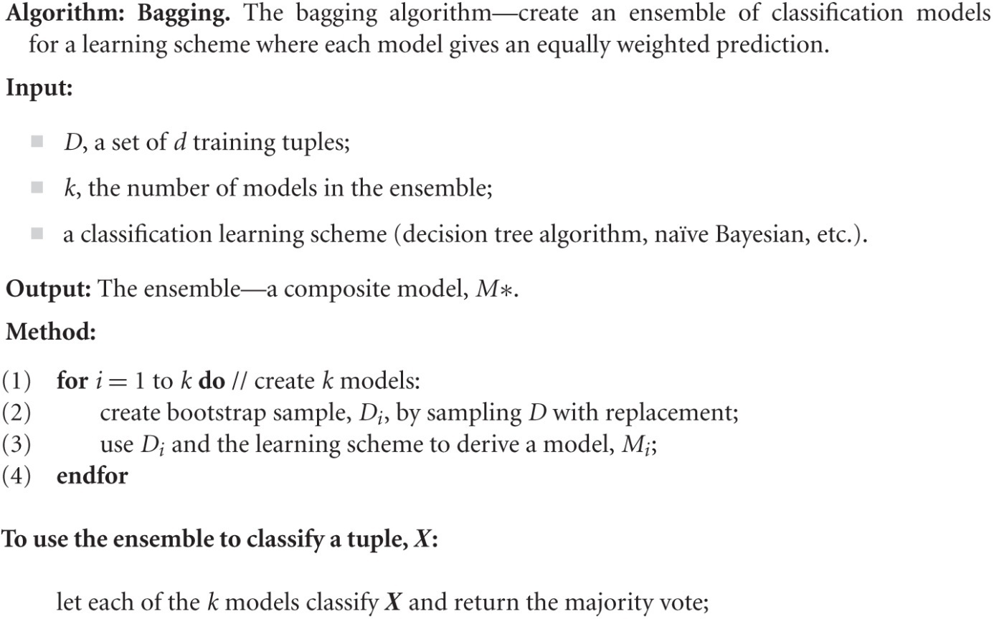
Bagging
Training
Given a set D of d tuples, at each iteration i, a training set D_{i} of d tuples is sampled with replacement from D (i.e., bootstrap)
A classifier model M_{i} is learned for each training set D_{i}
Classification: classify an unknown sample X
Each classifier M_{i} returns its class prediction
The bagged classifier M* counts the votes and assigns the class with the most votes to X
Accuracy
Often significantly better than a single classifier derived from D
Proved improved accuracy in prediction

Slide 11
Bagging Example
Consider 1-dimensional data set:
x = a one-dimensional attribute; y = the class label
Classifier is a decision stump (decision tree of size 1)
Decision rule: x ≤ k versus x > k
Split point k is chosen based on entropy to minimize the entropy of the leaf nodes
x ≤ k
True
False
y_{left}
y_{right}

Slide 12
Bagging Example
Without bagging, the best split is
at either x < 0.35 or x < 0.75.
The accuracy is at most 70%

Slide 13
Applying the bagging procedure
Using 10 bootstrap samples

Slide 14
Bagging Example

Slide 15
Example

Slide 16
Bagging Example
Summary of Trained Decision Stumps:

Slide 17
Bagging Example
Use majority vote (sign of sum of predictions) to determine class of ensemble classifier
Predicted Class

Slide 18
boosting

Slide 19
Boosting
Analogy:
Consult several doctors, based on a combination of weighted diagnoses—weight assigned based on the previous diagnosis accuracy
Comparing with bagging:
Boosting tends to have greater accuracy, but it also risks overfitting the model to misclassified data

Slide 20
Boosting
An iterative procedure to adaptively change distribution of training data
by focusing more on previously misclassified records
Initially, all N records are assigned equal weights (for being selected for training)
Unlike bagging, weights may change at the end of each boosting round

Slide 21
Boosting
Unlike bagging, weights may change at the end of each boosting round
Records that are wrongly classified will have their weights increased in the next round
Records that are classified correctly will have their weights decreased in the next round

Slide 22
Example

Slide 23
Example
Policy used
Records that are wrongly classified will have their weights increased in the next round
Records that are classified correctly will have their weights decreased in the next round
Suppose that Example 4 is hard to classify
Its weight is increased in the future iterations as it gets misclassified repeatedly.
Therefore, it is more likely to be chosen again in subsequent rounds

Slide 24
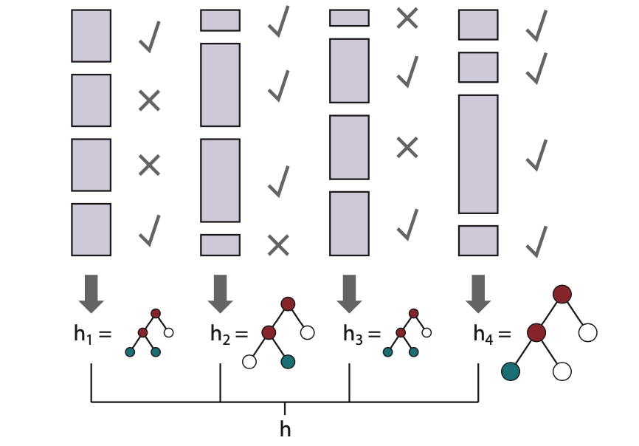
How the boosting algorithm works
The height of the rectangle corresponds to the weight.
The checks and crosses indicate whether the example was classified correctly by the current hypothesis.
The size of the decision tree indicates the weight of that hypothesis in the final ensemble.

Slide 25
How boosting works?
Weights are assigned to each training tuple
A series of k classifiers is iteratively learned
After a classifier M_{i} is learned, the weights are updated to allow the subsequent classifier, M_{i+1}
This is to pay more attention to the training tuples that were misclassified by M_{i}
The final M* combines the votes of each individual classifier,
where the weight of each classifier's vote is a function of its accuracy

Slide 26
Boosting
A greedy algorithm
It does not backtrack
Once it has chosen a hypothesis h, it will never undo that choice
Rather, it will add new hypotheses
A sequential algorithm
We cannot compute all the hypotheses in parallel

Slide 27
Boosting
The final ensemble lets each hypothesis vote (as in bagging)
Each hypothesis gets a weighted number of votes
The hypotheses that did better on their respective weighted training set are given more voting weights
The weight of each classifier’s vote is a function of accuracy.
The weight of hypotheses is distinct from the weighting of training examples

Slide 28
Readings
Geron, Chapter 5
Muller & Guido, Section 2.3.6 (p.84)
See the reference in the File /Readings/ of Canvas
Section 8.6 in Classification_Basic.pdf
Pages 51-60

